Slide 1
PROCESSES

Slide 2
Managing a Stage Boundary
Managing Stage Boundary
The purpose of Managing a Stage Boundary Process has two parts:
The Project Manager has to provide the Project Board with certain information.
The outputs of the Stage Boundary process are all for the Project Board.
This information will enable the Project Board to review the current stage, approve the next stage, review updated Project Plan, and confirm continued business justification.
The objective of the Managing a Stage Boundary Process gives an overview of the
main work that the Project Manager must do, which is:
Assure the Project Board that all products in the current stage are produced & approved.
Review and update, if necessary, the usual documents, which are the Project Initiation Documentation, Business Case, Project Plan, and Risk Register.
Record any lessons in the Lessons Log that can help in later stages or in future
projects.
Prepare the Stage Plan for next stage and Request Authorization to start the next stage.

Slide 3
Managing Stage Boundary
Following are the activities performed by the project manager in Managing a
Stage Boundary Process.
Ensure and communicate to the Project Board that all products in the Stage Plan for the current stage have been completed and approved
Review and, if necessary, update the Project Initiation Documentation (in particular the Business Case, Project Plan, project approach, strategies, project management team structure and role descriptions)

Slide 4
Managing Stage Boundary
Provide the information needed for the Project Board to assess the
continuing viability of the project and the aggregated risk exposure such as
An End Stage Report produced by the Project Manager and given to the Project Board, outlining information on the current stage achievements.
Current Stage Plan Actuals showing the performance against the original
Stage Plan
An updated Risk register, together with the Updated Business Case and Project Plan, which is used by the Project Board to review that the Project has continuing ongoing viability.
An updated Configurable item record and Product Status Account Any changes to the Project Management Team with updated Job Descriptions.

Slide 5
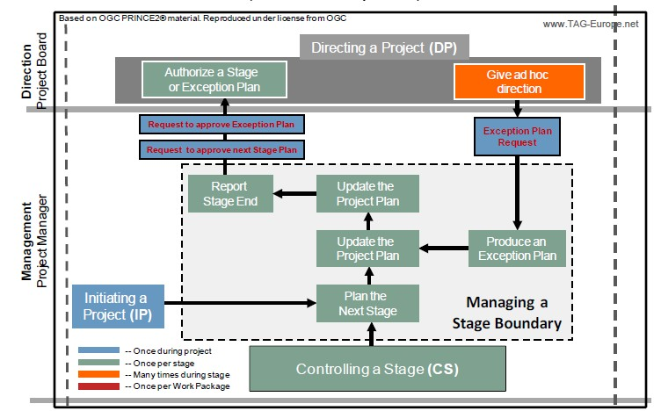
Managing Stage Boundary

Slide 6
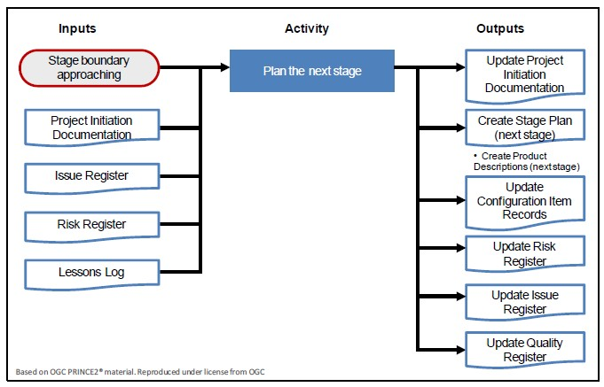
Managing Stage Boundary

Slide 7
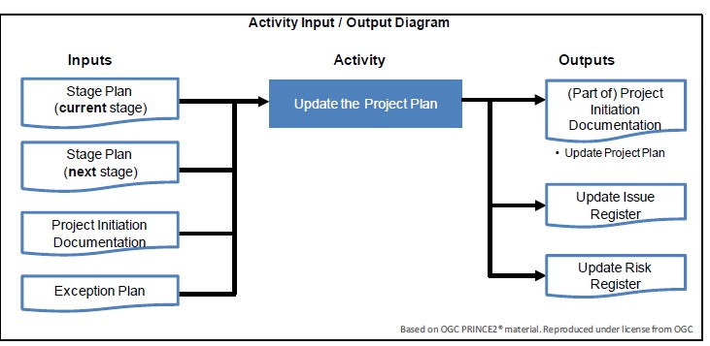
Managing Stage Boundary

Slide 8
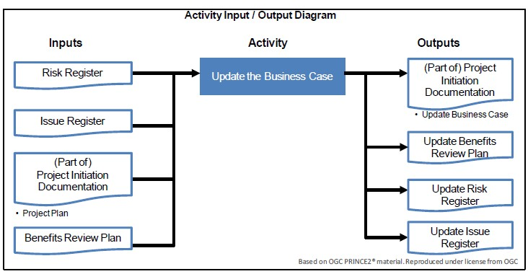
Managing Stage Boundary

Slide 9
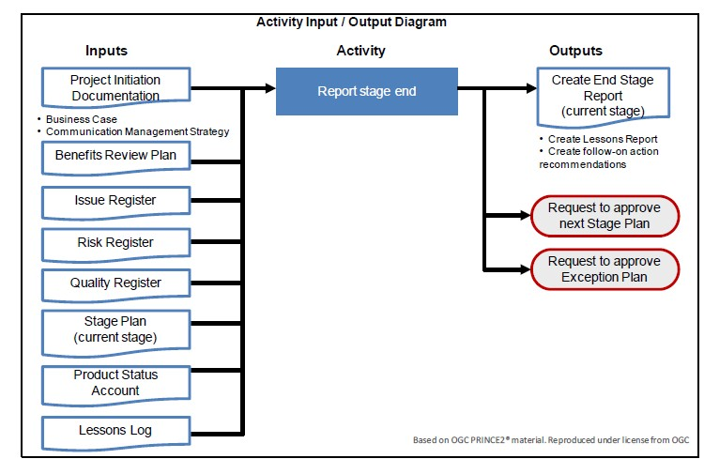
Managing Stage Boundary

Slide 10
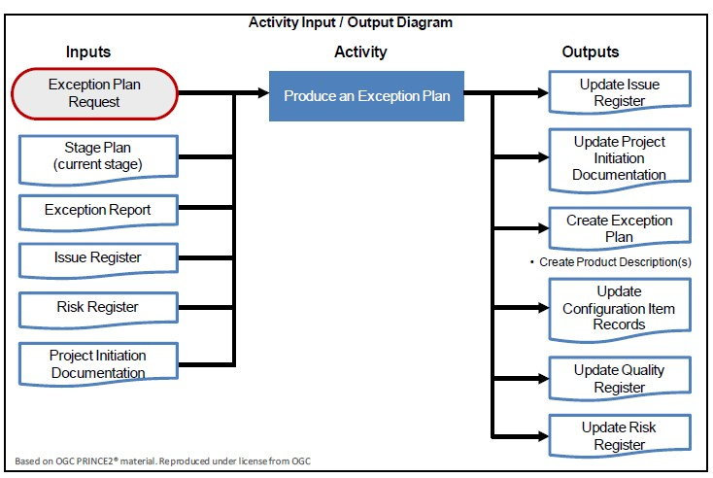
Managing Stage Boundary

Slide 11
Closing a Project
The purpose of the Closing a Project Process is to provide a fixed point to check that the project has reached its objectives and that the products have been accepted.
The objective of the Closing a Project Process is to: Verify user acceptance of the project’s products.
Ensure that products can be supported after the project is disbanded.
Review the performance of the project. This is done by comparing the project to the baselined documents.
Assess the benefits already realized and plan review of benefits that will be realized after the project is complete.
Address open issues and risks with follow-up on action
recommendations.

Slide 12
Closing a Project
The activities performed in this process are:
There are 5 activities in the Closing a Project Process for the Project Manager and
they are:
Preparing planned closure, i.e., confirming the completion of products and their acceptance.
Preparing premature closure: This is done instead of the “prepare planned
closure” activity if requested by the Project Board.
Handover of products: Hand over products to customer, as described in the Configuration Management Strategy document.
Evaluating the project, i.e., comparing the project objectives with the actuals
and writing the End Project Report.
Recommending project closure, i.e., sending a notification to the Project Board to close the project.

Slide 13
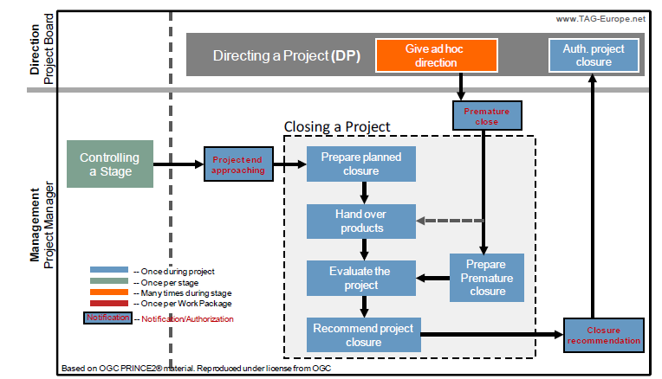
Closing a Project

Slide 14
Closing a Project
Prepare Planned Closure – Activities
The Project Manager does the following :
Project Plan: Update the Project Plan to show what products have been delivered.
Product Status Account: Request from Project Support a document called “Product Status Account.” This is a short report on the status of all products, such as Product Identifier, Status: Accepted and so on.
Meet Acceptance Criteria: Confirm that the project has delivered what is defined in the Project Product Description, and that the acceptance criteria defined in the Project Description has been met. The Project Board will also check that all products have been accepted and signed for and the acceptance criteria have been met; and
Lastly, seek approval that project resources can be released (e.g., equipment used for the
project, contractors and rooms) so that these do not continue to be charged to the project.
Once these steps are done, the Project Manager is ready to hand over the products, complete the End Project Report and then recommend project closure.

Slide 15
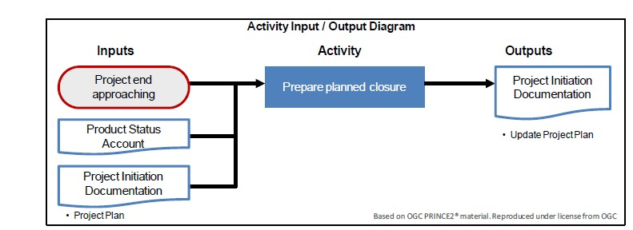
Closing a Project

Slide 16
Closing a Project
Closing a Project
Prepare premature closure
Sometimes the Project Board will instruct the Project Manager to close the project. The Project Manager will not just abandon the project but should try to salvage anything of value so it can be used again.
PRINCE2 recommends the following actions:
Record Premature Close: Record the Premature Close Request in the Issues Register.
Project Plan: Update the Project Plan with actuals from the current stage. The Project Plan will show what was completed when the project was closed.
Product Status Account: Request from Project Support a Product Status Account so that you can identify Products developed, currently under development, to start, etc. Products that need to be made safe and may be useful to other projects.
Products: Agree what to do with the completed products and products that are currently under development. This might require extra work, as there may be a request to complete one of the products first before shutting down.
Lastly, seek approval from the Project Board that project resources can be released, so that the project can stop being charged for these resources.
Once this is done, the Project Manager will follow the next activities which are to hand over the products, complete the End Project Report, and recommend project closure.

Slide 17
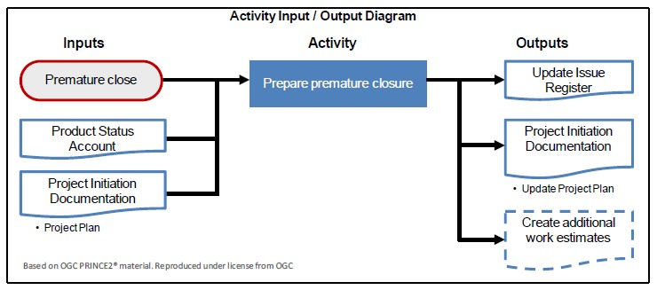
Closing a Project

Slide 18
Closing a Project
PRINCE2 recommends the following in Handover products activities:
Follow on Action Recommendations
Prepare the follow-up on action recommendations for the products. These are mostly taken from the Issues and Risk Registers.
Check that the Benefits Review Plan includes post-project activities to confirm benefits that cannot be
measured until after the products have been in operation for some time.
Configuration Management
The Configuration Management Strategy document will describe how the products should be handed over. Some common steps here are:
Confirm that correct operation and maintenance environment is in place.
Consider the early life-support requirements of products, as this is often where the most support is needed.
Check if a support contract is required and get it drawn up if necessary.
Confirm acceptance from the operations for the products and obtain acceptance records, as these are required by the Project Board.
Lastly, transfer responsibility to operations for the products and register this in the Configuration Item Records to show who the current owner of the products is.

Slide 19
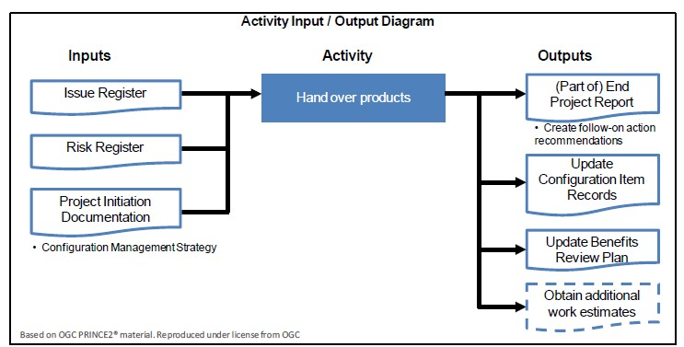
Closing a Project

Slide 20
Closing a Project
Evaluate the Project
The objective of this activity is to assess how successful or unsuccessful the project was and to learn from this project.
End Project Report:
The Project Manager will compare the current documents in the Closing a Project Process such as the Project Plan and the Business Case with the baselined documents.
The Project Manager will do the following to create the End Project Report: o Prepare a summary of how the project performed.
Review the project benefits delivered so far compared to the expected benefits. o Review how the project performed against its planned targets and tolerances.
Review team performance.
Review of the Project Products.
Lessons Learned Report:
The Project Manager will work with the Project Management team to prepare a Lessons Learned report. This will be used to benefit future projects. The Lessons Learned report should include the follow information:
A review on how the project went, what went well and what could be improved.
How effective the Quality Management Strategy was in designing, developing and delivery for purposed products;
Any useful information gained regarding the tailoring of PRINCE2.

Slide 21
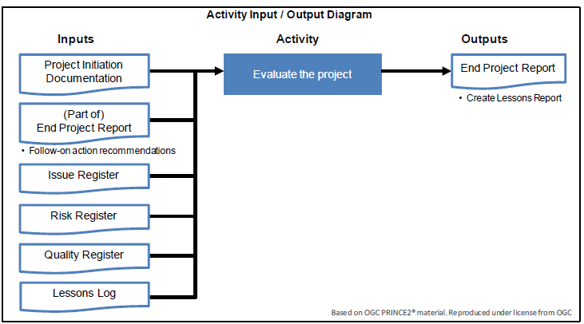
Closing a Project

Slide 22
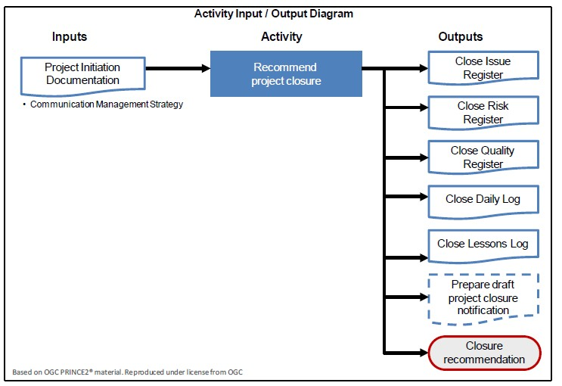
Closing a Project
Remember, it is the Project Manager that prepares the project for closure but it is the Project Board who closes the project or, in PRINCE2 words,“authorizes project closure.”

